Slide 1
Impactful mentorship
2 sides of a story
Notes:
Session is about getting involved with the community and becoming a new speaker, and what we learned in this process as mentor and mentee
O

Slide 2



Introduction
Olena Borzenko
Xpirit
@borzenko_lena
Eldert Grootenboer
Motion10
Azure MVP
@egrootenboer
Notes:
O & E

Slide 3
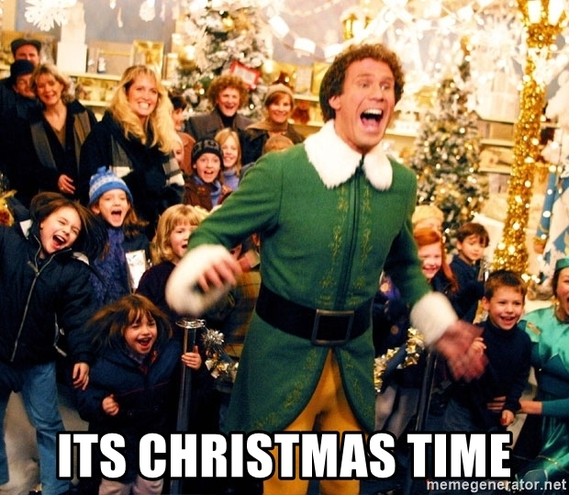
Starting point
Notes:
Met at Dylan’s party
Became friends right away
Over time started talking about community, conferences, and speaking
Eldert explained how life as a speaker is, what comes with it, both good and bad Olena showed an interest in becoming involved with the community, but didn’t know where to start
O

Slide 4
Starting point
Understand what you want through observation
Notes:
O

Slide 5
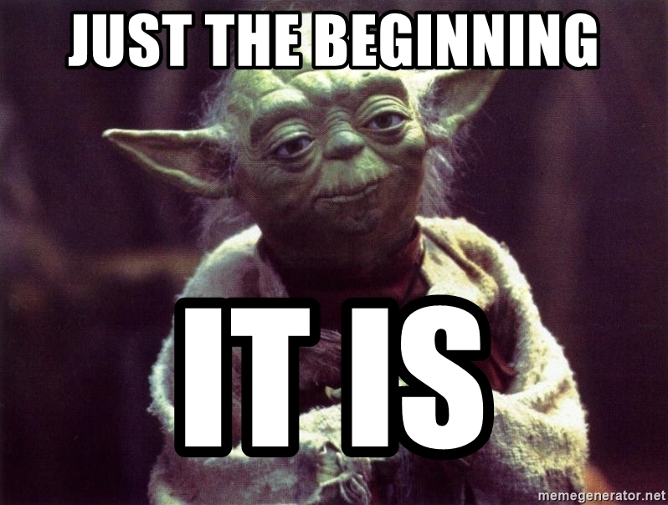
Notes:
Understanding what exactly I want was a starting point into unknown
O

Slide 6
Getting involved in the community
Notes:
E

Slide 7
What are the options?
Speaking
Blogging
Writing
Video recording (tutorials, knowledge sharing…)
Code contribution, etc.
Notes:
E

Slide 8
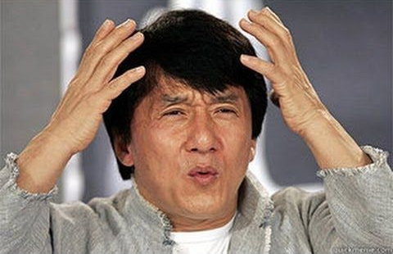
Notes:
O

Slide 9
Step into the unknown
What can I talk about?
Share your story.
How to create a session?
First describe it shortly.
Where can I submit my session?
Start from online events and meetups
And 1000 more…
All of them were answered…
Notes:
O + E
Once I made up my mind that I want to be a speaker, I want to share what I know and be part of the community, I realized how many questions I got in a second in my head. Of course, everyone around me were extremely supportive. Our friends were sharing their experience in public speaking, were answering my questions and helping me to understand what is “my thing”. But still, with Eldert we had quite a lot of conversations going non-stop about work and IT in general. And most of the time he was the one I was addressing most of my questions.

Slide 10
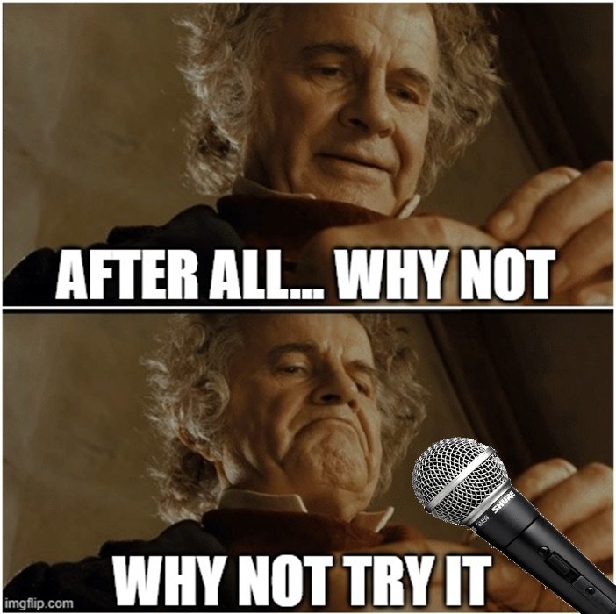
How did we come to mentoring?
Notes:
E + O
At some point Eldert proposed to mentor Olena. As Olena was still not sure is she can make it (speaking), it took some time to make this decision. But in the end…Why not to try? We had a conversation about “mentoring” itself…and as far as I remember we didn’t get to a conclusion…we decided to see how it goes. But in general definition was smth like “I can help you to understand how everything works and give you my opinion, but you will decide what to do with that”

Slide 11
So, you want to be a public speaker
Understand what attracts you in public talks
The Art of Code - Dylan Beattie
Notes:
O

Slide 12
So, you want to be a public speaker
Find a session format that is comfortable for you
Notes:
E

Slide 13
Setting up content
Notes:
E

Slide 14
Pick the topic
You must be passionate about it
Notes:
O
Why was it so hard to create a first session? Expectations or I’d say illusion that you have to be a pro in the area to share your experience was limiting me a lot when I was trying to choose a topic. What changed? Advices from everyone around that session it’s smth I want to share, what I learned, and my experience rather than smth people can just google.
Doesn’t matter how many people already talking about smth similar, your story is unique.
No one will have an interest in your session if even you are not interested

Slide 15
Pick the topic
“It doesn't have to be groundbreaking, or difficult, or important, most things are not :)”
-David Whitney
Notes:
O

Slide 16
Deciding on a subject
Everyone has Google…but not everyone has your experience
Notes:
E

Slide 17
Now, the even harder part
How to write an abstract and choose the title?
Notes:
E

Slide 18
Writing an abstract
Should give enough details about your session
Make it attractive for organizers and attendees
Read Dylan Beattie’s “How (Not) to Respond to a CFP” and Martin Thwaites “From 1000 submissions to 100 slots, the story of the 10%”
Notes:
E

Slide 19
Writing an abstract
If you have a cat, I’m super jealous. But we all know how hard it is to teach them not to jump on a dining table…
What is the problem?
In this session, I’ll show you 5 different ways how to avoid that problem…
How do we solve this?
Using simple scotch tape, we’ll see how our cats will start hating us in just a couple of days…
Additional details
Notes:
O

Slide 20
First steps as a speaker
Notes:
E

Slide 21
Finding a place to speak
Keep track of CFPs
Contact local user groups
Discuss with your network
Notes:
E

Slide 22
Setting up a slide deck
Make it an iterative process
Story to guide through your session
Bring your own personality
How to avoid death by PowerPoint
…and more memes
Notes:
O
David JP Phillips

Slide 23
Preparing your first session
Talk to yourself
Practice multiple times
Use an audience while practicing
Rehearse with Coach in PowerPoint
The 110 techniques of communication and public speaking
Notes:
O
It’s ok to be nervous. At least a few days before the event, try to present your session to yourself for a few time in a different ways. Play a bit with the way how you explain things. Of course, in the end you’ll say it differently, but practicing will help you not to get lost or freeze because of stress. Notes are helpful, but make sure you’re not reading everything. Also make sure you don’t have a lot of text. Once you’ll start reading it will be very hard to get back to your thoughts. And pay attention that you are in sync with slides, transition between the topics is smooth and you’re not jumping back and forth.
David JP Phillips

Slide 24
Promotion and interaction
Interact with the events on social media
Tell people what your session is about
Include important links
Notes:
Public speaking or any other activity like that is not just speaking or writing, it’s also about letting people know that you’re willing to share. Interacting with the events, other people, communities, etc. will help you to find a place where you and your story can be a great fit. But besides that, it will also help you to find your audience and your audience to find you.
E

Slide 25
First time speaking virtually
Think about your equipment and background
Stay calm and tell your story
Find ways to engage the audience
Notes:
Use proper and tested equipment, and remember, your background tells something about you
People are there for your story, no one minds if you make a mistake, just stay calm
Engage the audience, maybe they can come on audio, in chat, etc.
E

Slide 26
First time speaking virtually (tips)
Glass of water or something else
Write down important/complicated things
Temperature level (not too cold/hot)
Talk slowly and take a break for a few seconds when needed
Remember people can see you, try to smile a bit
Try to change intonation when needed
And relax…you will do amazing!
Notes:
Feeling cold might not be an issue as from stress you’ll probably got warm quite fast. On the other hand, feeling hot from the start, might give you a feeling that your brain is melting, especially if the session is intense.
O

Slide 27
Leveling up to the next level
Notes:
E

Slide 28
How to keep the momentum
Submit to multiple events
Prepare multiple sessions
Keep interacting with the community
Notes:
Multiple sessions around the same scenario and technologies
E

Slide 29
Managing your schedule
Block sessions on your calendar
Have enough downtime
Take conference times into account
Notes:
Keep an overview of all your appointments
O

Slide 30
Keeping things fresh & interesting
Re-use, but keep updating
Include new features and experiences
Keep thinking about new sessions
Notes:
Re-use sessions, without creating new ones all the time
E

Slide 31
First in-person conference
No rush, breathe and think
Interact with your audience
Visit the other sessions
Get to know people at the event
Don’t be afraid of questions
Notes:
Visit other sessions to learn about tech, but also to watch others speak and support them
O
Don’t be afraid of questions, if you don’t know all the answers it’s ok

Slide 32
Getting started yourself
Notes:
E

Slide 33
How to start on your own journey
Decide your own path
Connect to your local community
Start building your own content
Notes:
E

Slide 34
Mentorship
Find someone you align with
No hierarchy, just work together
Only guidance, the rest is on you
Enjoy the journey!
Notes:
As a mentor, support, don’t try to replicate yourself
O

Slide 35
No exceptions
And remember, everyone has to start somewhere!
Notes:
O + E

Slide 36



Thank you!
@borzenko_lena
olena-borzenko
borzenko.olena
@egrootenboer
eldert-grootenboer
eldert.grootenboer
Notes:
O + E

